Slide 1

Employment Statistics in the US and the factors affecting them
University of Minnesota - Data Visualization
Project 1 – Team 2
Ankur Srivastava
Joseph Conroy
Renee Sandidge

Slide 2
- Visualize the shift in occupations from 1979 to 2018 - Investigate the difference in pay between gender and age demographics - Does gender still play a role in employment and pay in the 21st century? How far have we come to bridge that gap since last 3 decades? - Is there a correlation between income and education? - Examine the historical precedence between race and wages earned
Analysis Topics

Slide 3

We used the data gathered from Bureau of Labor Statistics which contained 26 sheets with hundreds of lines. We as a team analyzed the data and took 6 sheets with 4 of these factors into consideration. We'll talking about it in the next few mins. We used Pandas to cleanup the data frame, while Matplotlib was used to chart the data and get the graphs and stats for a visual summary

Slide 4
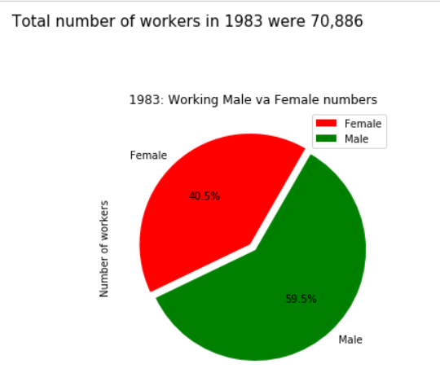
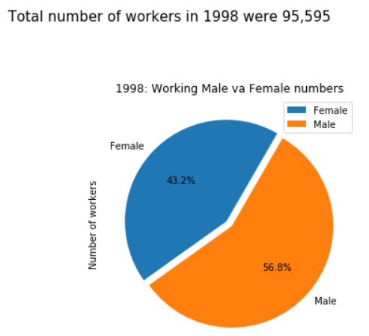
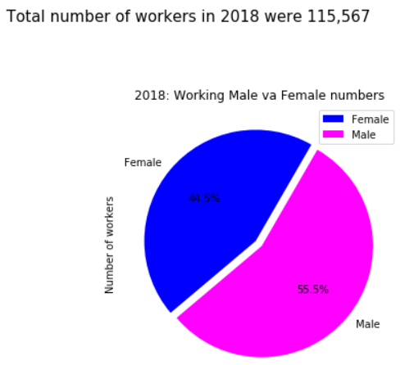
This data shows how the number of workers within the US have increased over the years. Based on the data gathered from BLS, it can be derived that within the US male population still dominates the work aspect. The numbers show a positive trend though. While in 1983, close to 40% of the total work population were women, it has jumped up to ~44% in 2018.
The narrative we can define from this data is that a greater number of women have started working in the 21st century than they did in the 19th century.
Even though the percentage increment of working women population is still low as compared to men, the percentage is showing a constant increment based on the given data.

Slide 5
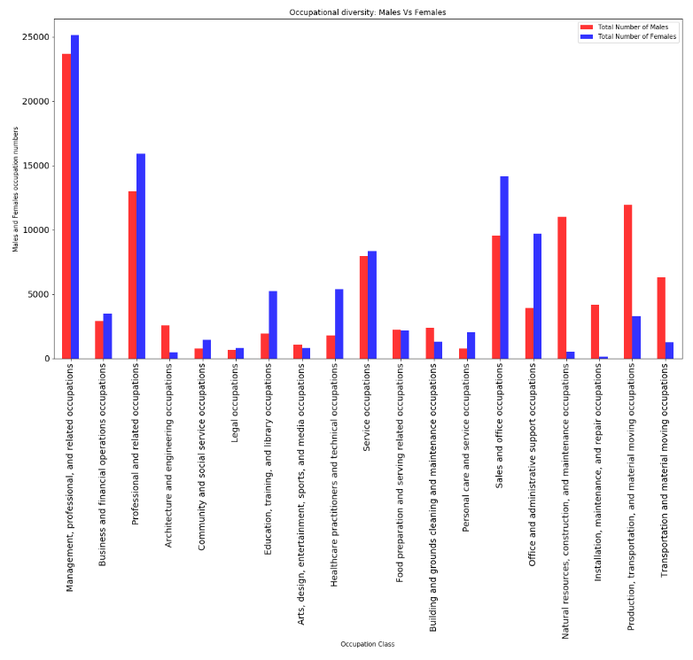
OCCUPATIONAL DIVERSITY
Based on the data gathered via BLS, we can clearly see in some job fields like management, sales and administrative occupations, females have a greater number as compared to men.
However areas like Production, transportation. Construction and Maintenance are still male dominated work areas.
Overall, there is still a significant difference between male and female worker numbers.

Slide 6
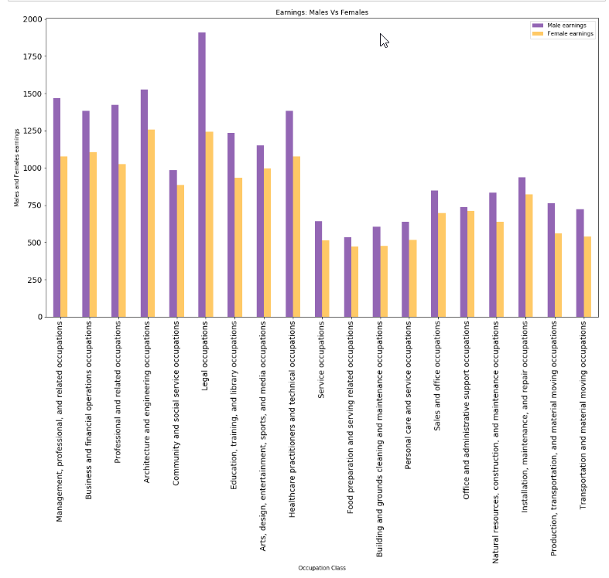
EARNING DIFFERENCES
Gender based pay has been a center of discussion for a long time now.
Even though it is believed that, this gap has reduced over the years, but based on the data presented by BLS we can see that females are still being paid less than their male colleagues.
Although the reason for these differences cannot be known via this data, the only certain derivative we can deduce from this given chart is that in all the given job areas, men are being paid better than women.

Slide 7
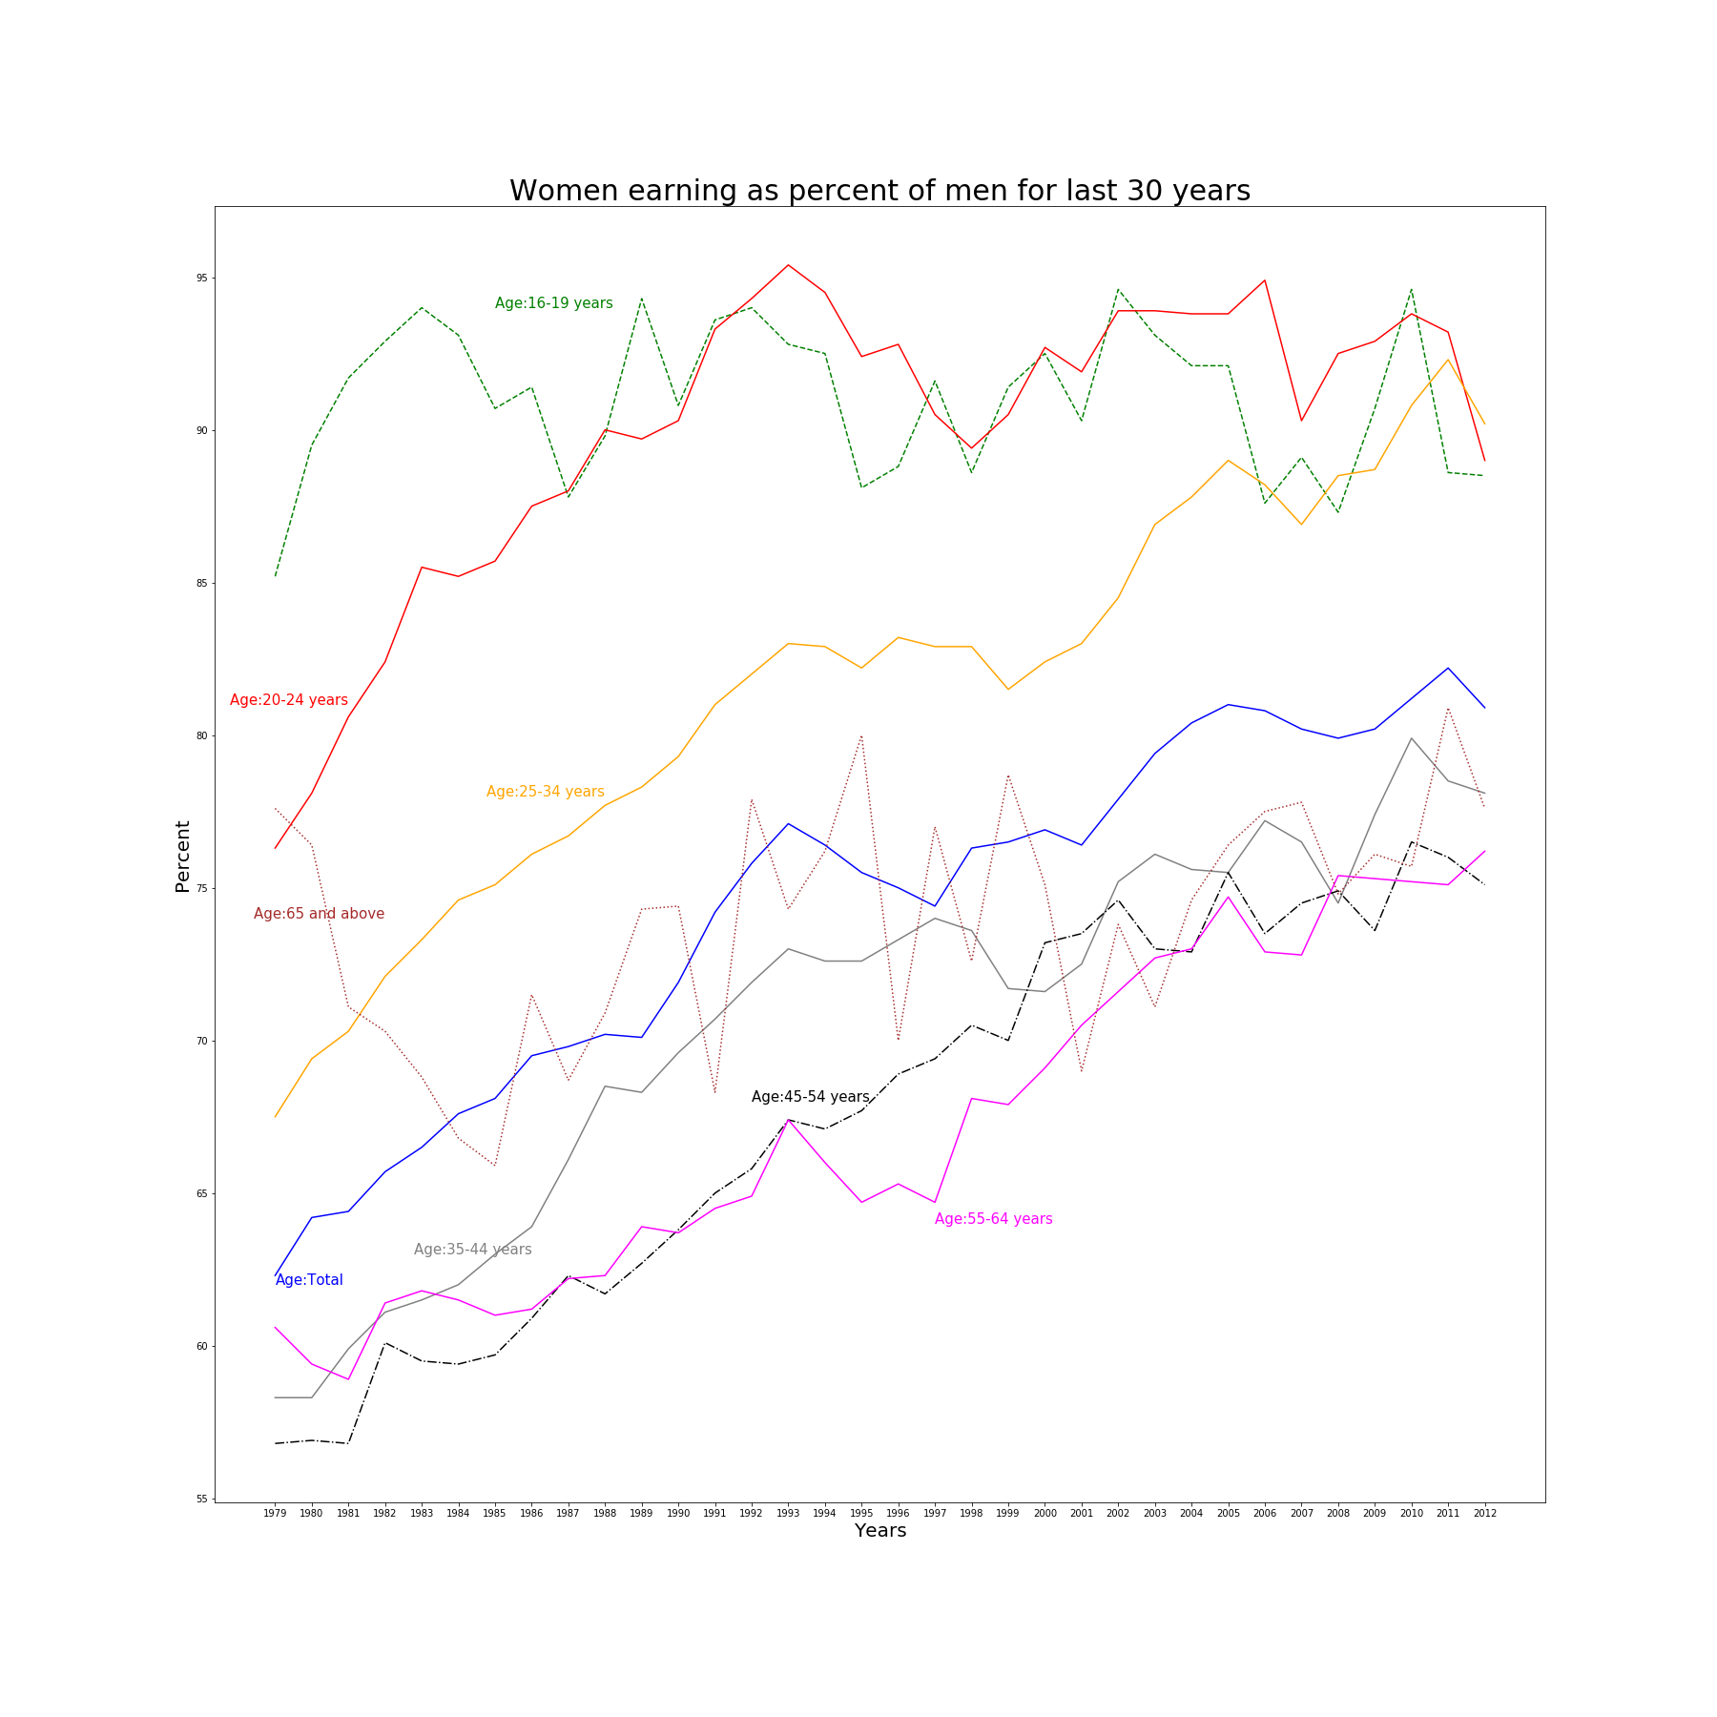
WOMEN’S EARNINGS: 1979-2012
In 2012, women who were full-time wage and salary workers had median usual weekly earnings of $691. On average in 2012, women made about 81 percent of the median earnings of male full-time wage and salary workers ($854). In 1979, the first year for which comparable earnings data are available, women earned 62 percent of what men earned.
The graph here shows the salary variance among women of different age groups over the years. Based on the data collected from the Bureau of Labor Statistics, the only thing that can be fairly concluded is that even though the pay percentage has improved for women over the course of years, even in 21st century women are still finding their ground to have a right to equal pay as men!

Slide 8
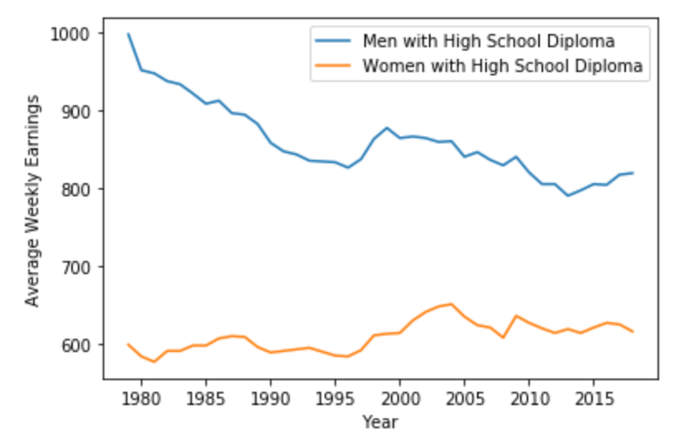
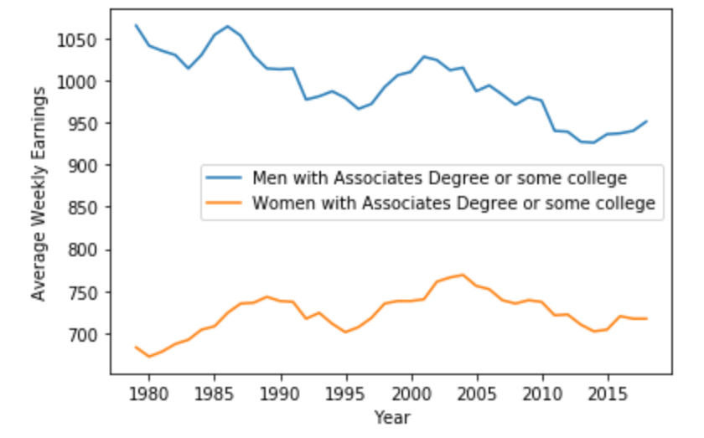
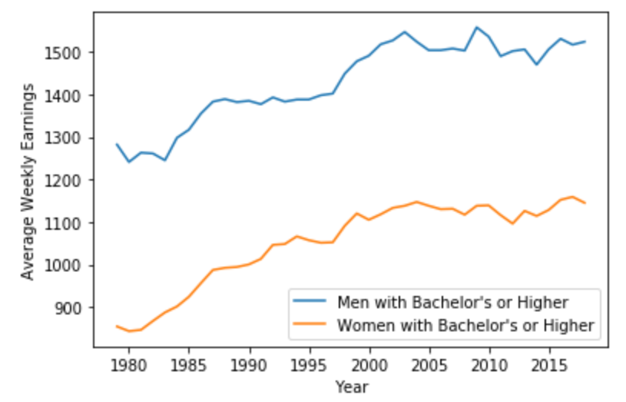
Gender , Education and Income
- Women earn 74 cents for every dollar men make.
- The average weekly earnings for female high school graduates has seen little change from 1979. While men with the same degree have seen a significant decrease in average weekly earnings.
- Men and women with a bachelor’s degree or higher have seen similar increases in average weekly pay since 1979
Gender | High School | Some College | College Degree
Men | $ 859.93 | $ 994.80 | $ 1430.58
Women | $ 609.85 | $ 723.33 | $1051.63

Slide 9
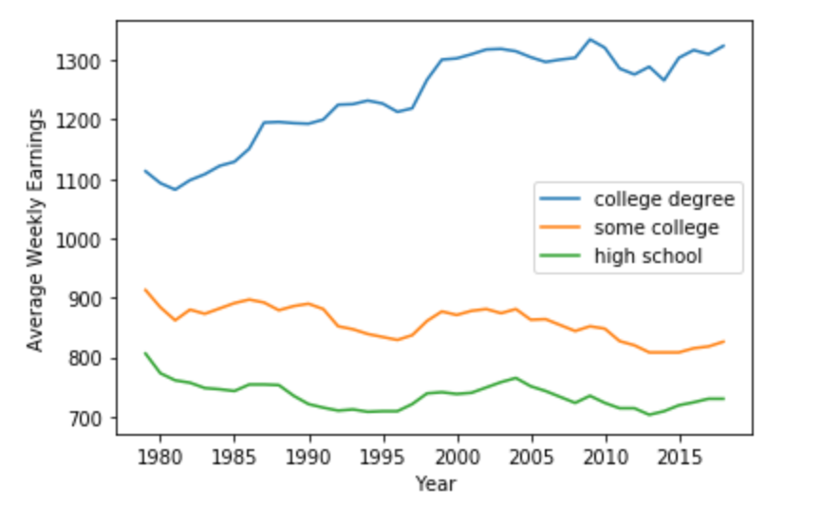
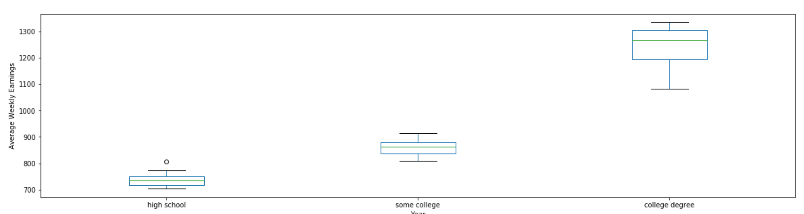
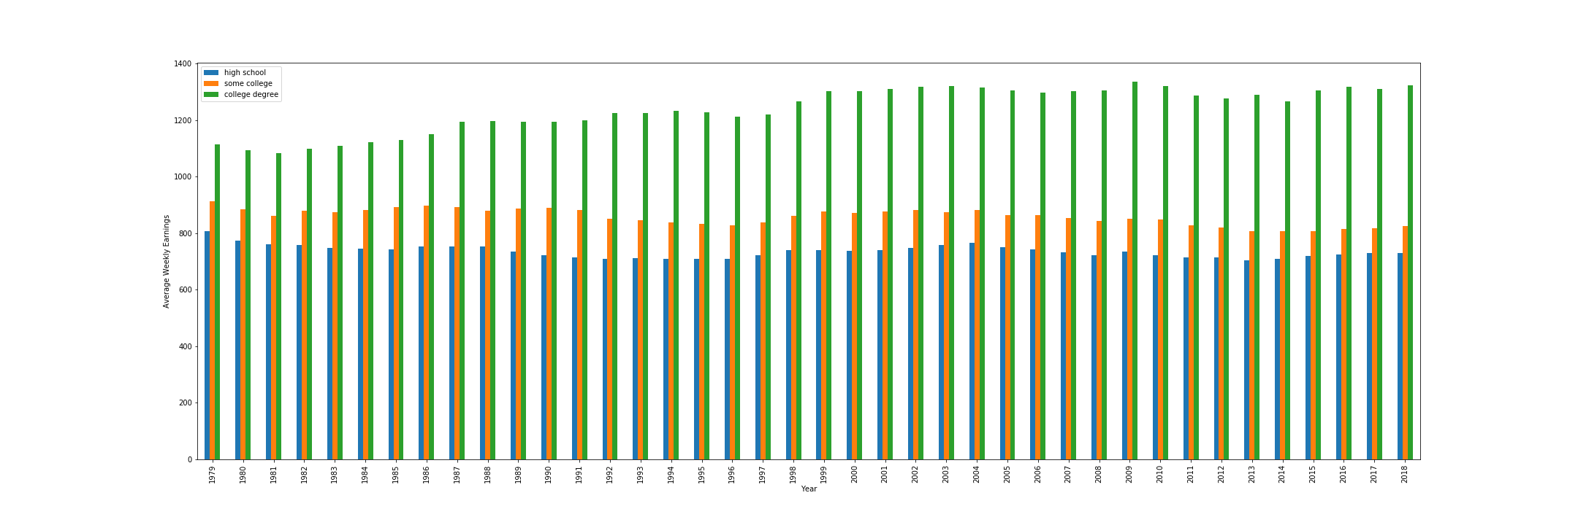
Correlation between education and income
-Although more education can lead to higher earnings; the pay gap is wider among those with a bachelor's degree
- The most significant difference is between those that have some college education and those that have a bachelor’s degree
- There is not a significant difference between those with a high school diploma and those with some college

Slide 10
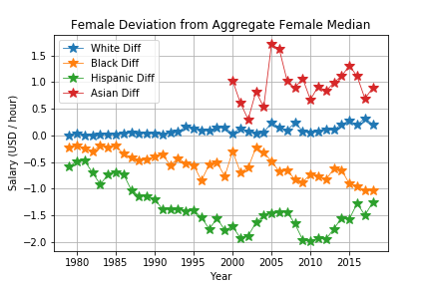
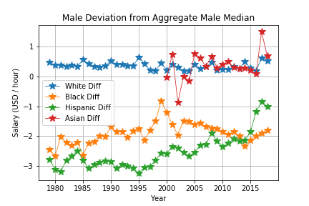
NON-WHITE WORKER TRENDS
Black and Hispanic workers are consistently beneath the median salary for each of their sex categories between 1979 and 2018. While not tabulated until 2000, Asian men consistently had a median salary above the median salaries across all racial categories. Asian women worker’s median salaries tended around the average white female worker’s median salaries with visible spikes either above (2017) or below (2002) the average salary for white female workers.
WHITE WORKER TRENDS
The data reflects a constant trend in which white workers, either male or female, were above the average salary and within 50¢ to $1/hr. of the average salary of their respective sex category. This demonstrates how much the white workers’ salaries influences the average salary across all racial groups and indicates that white workers for either category contribute largely to the total number of workers. The fact they have annual average salaries above the total averages implies that white workers also make more than the average salary across both sex categories.

Slide 11
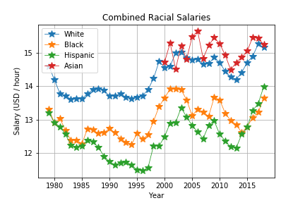
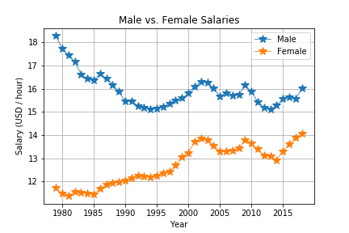
HOW RACE AFFECTS WORKERS’ WAGES (BOTH SEXES)
The data shows us that white and Asian workers had the highest average wages while Hispanic and Black workers had the lowest wages. All race categories appear to exhibit similar rise- and fall-patterns between each other over time that reflect a shared impact from economic events (such as the recession following the 2008 financial crisis). White and Asian salaries stay above $14/hr post 1997 while Hispanic and Black workers have yet to pass $14/hr by 2018.
HOW SEX CATEGORY AFFECTS WORKERS’ WAGES (ALL RACES)
The two most noteworthy portions of the chart comparing annual average wages between the sexes are the periods of 1979-1995 and 1995-2018. In the chronologically first period of time, there was a drop in the male annual average salary and a rise in the female salary. This could reflect a rise of the female presence in the workforce that drives the medians of each category closer to the median between the two during this time. The second time period shows a mirror-like relationship between the two sexes’ average salaries. This indicates that both categories had similar reactions to market trends. It also indicates that the differences in the average salaries between the two sexes did not change as significantly as they did in the first time period.

Slide 12
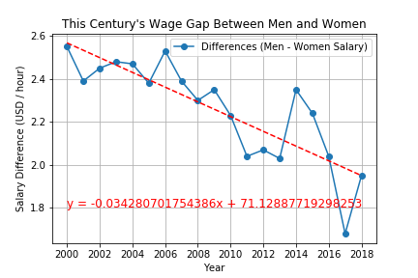
The chart on the right was created by taking the average men’s salary for each year post-1999 and subtracting the average women’s salary of each respective year. This was done to reflect the current trend in the differences bewteen men’s and women’s salaries for this century (21st). The slope and correlation coefficent imply that there is a clear decline in the differences between men’s and women’s annual average salaries as the years progress. However, the probability of recurrence (p-value) is less than 0.0001 which indicates that replicating this phenomenon would be unlikely should this data be collected for different time periods. The standard error being below 0.01 suggests that deviation from the estimated linear relationship would expected to be rather small.
Summary Statistics From This Chart
Rate of change: ~(-0.0343) Probability of Recurrence: ~1.0741*10⁻⁵ Estimate for Year 0: ~71.1289 Correlatin Coefficient:~( -0.8305)
Standard Error: ~0.0056

Slide 13
Conclusions
There is also still a significant gap between the earnings of men and women
White workers tend closer to the average salary, while Asian workers remain relatively above it
There is a relationship between race, sex and the average wage
Hispanic and Black workers have consistently had the lowest average annual wages regardless of their sex category
Men have consistently had higher average wages then women from 1979 through 2018, though there appears to be a slight downward trend
Gender plays a key role in affecting employment numbers and wages
There are still job areas with major male dominance while females have surpassed men in numbers in some areas.
Education could lead to a higher pay
Correlation does not mean causation

Slide 14
References
Primary Source
https://www.bls.gov/data/
Secondary Sources
https://www.census.gov/
https://www.nytimes.com/2014/09/11/business/economy/a-simple-equation-more-education-more-income.html

Slide 15

QUESTIONS?

